Slide 1

Capstone TWO – final presentation (Effect of COVID19 on stock market)
Presented By – Sangeeta Chatterjee

Slide 2
Capstone one – final presentation (Prognosis of Chronical Heart Diseases)
Presented By – Sangeeta Chatterjee
Date – May – 17Th , 2020

Slide 3
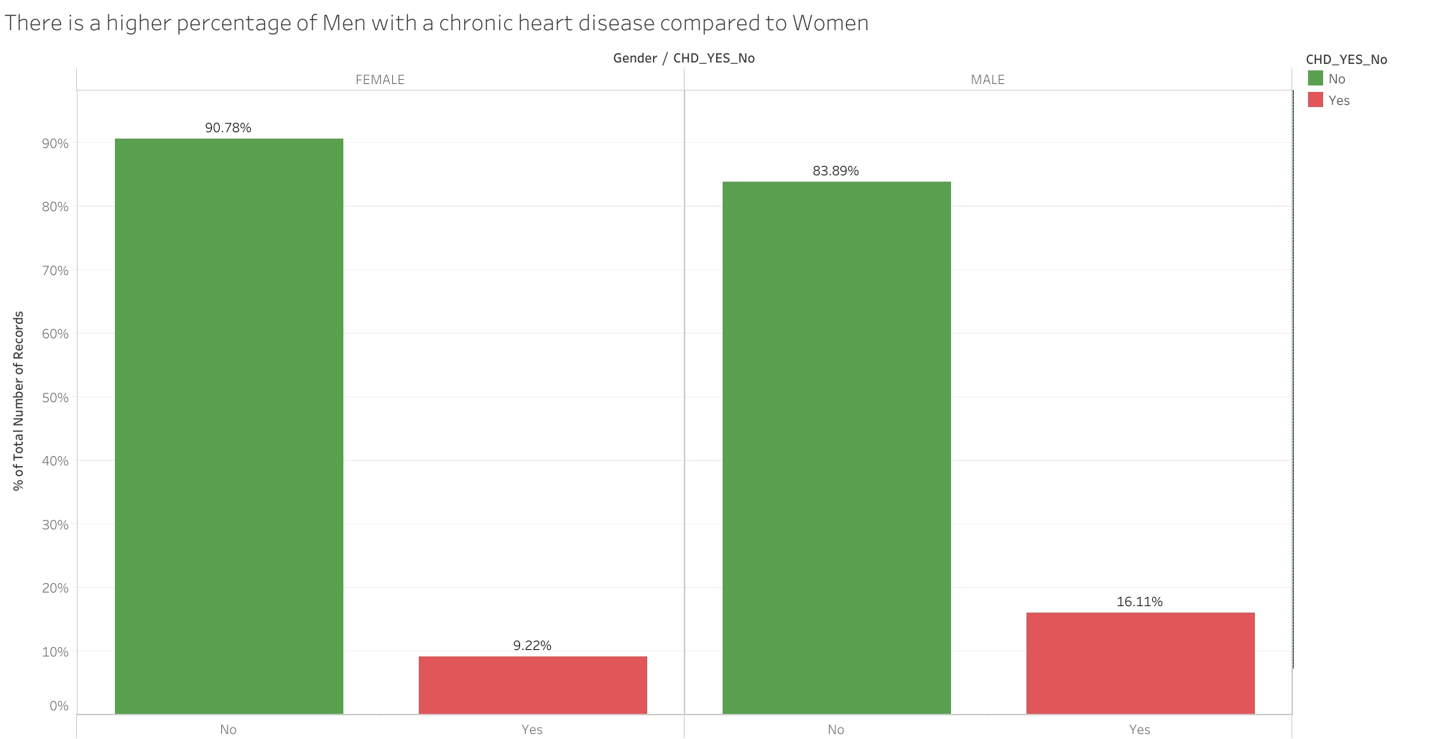
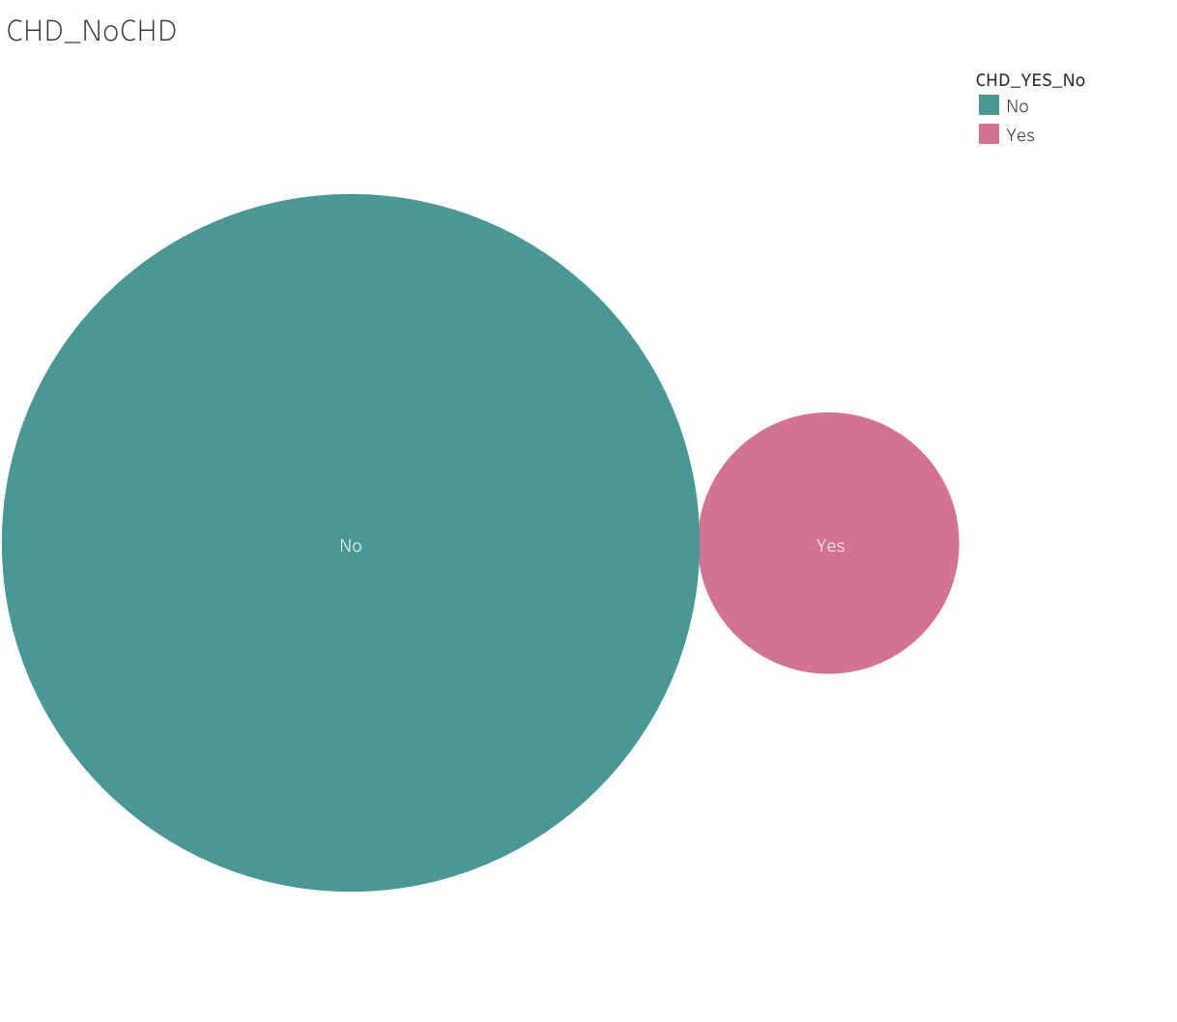
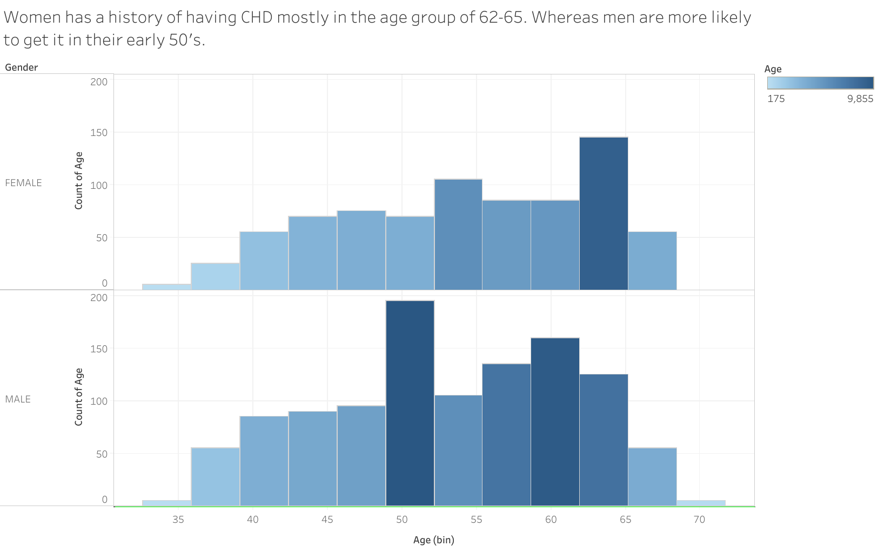

One of the leading reasons for death in US is Coronary or heart disease. Early prognosis of the disease by studying various factors like medical, demographic and behavioral in existing patients is done here, to find a possible trend that could help high risk patients in making appropriate changes in current lifestyle to avoid future occurrence of this disease .
Men tend to have a CHD earlier on in life compared to women
87.6 % never had a chronic heart disease and 12 % of the dataset had a history of heart disease.
Men have a higher rate of CHD compared to women
Key Insights
Certain behavioral factors like smoking shows a negative correlation while others seems to have negligible increase .
Medical factors BP and Cholesterol shows very slight increase with CHD present.
The sample should be extended to include more positive number of data and probably more attributes should be considered to get a better conclusion.
Note: ¹ Data is collected from ongoing cardiovascular study on residents of the town of Framingham, Massachusetts.
Note: ² It includes over 4,000 records and 15 attributes.
Source: https://www.kaggle.com/dileep070/heart-disease-prediction-using-logistic-regression

Slide 4
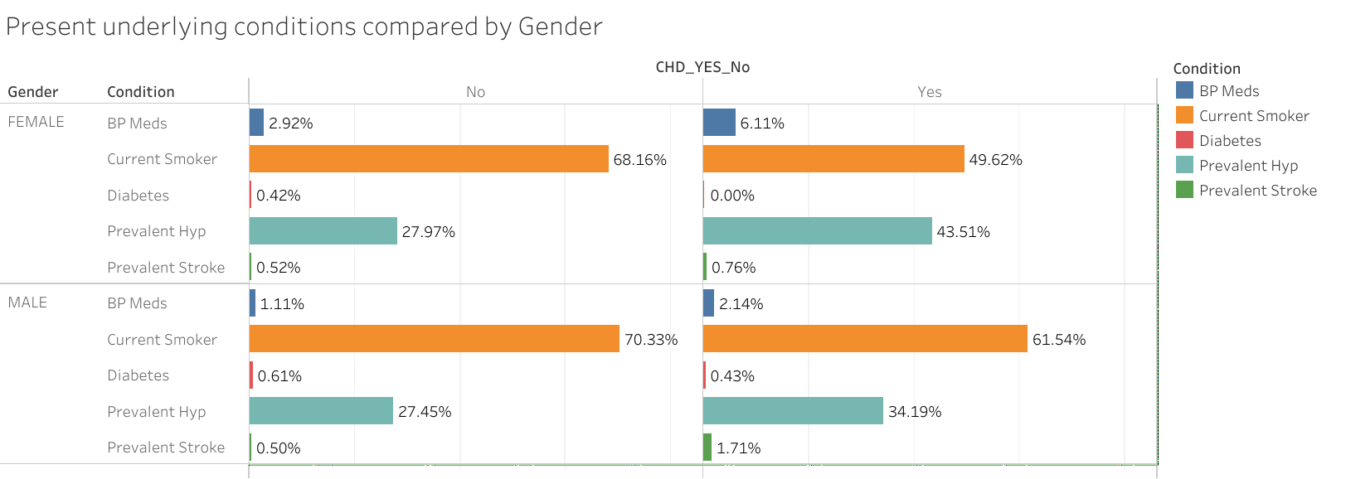
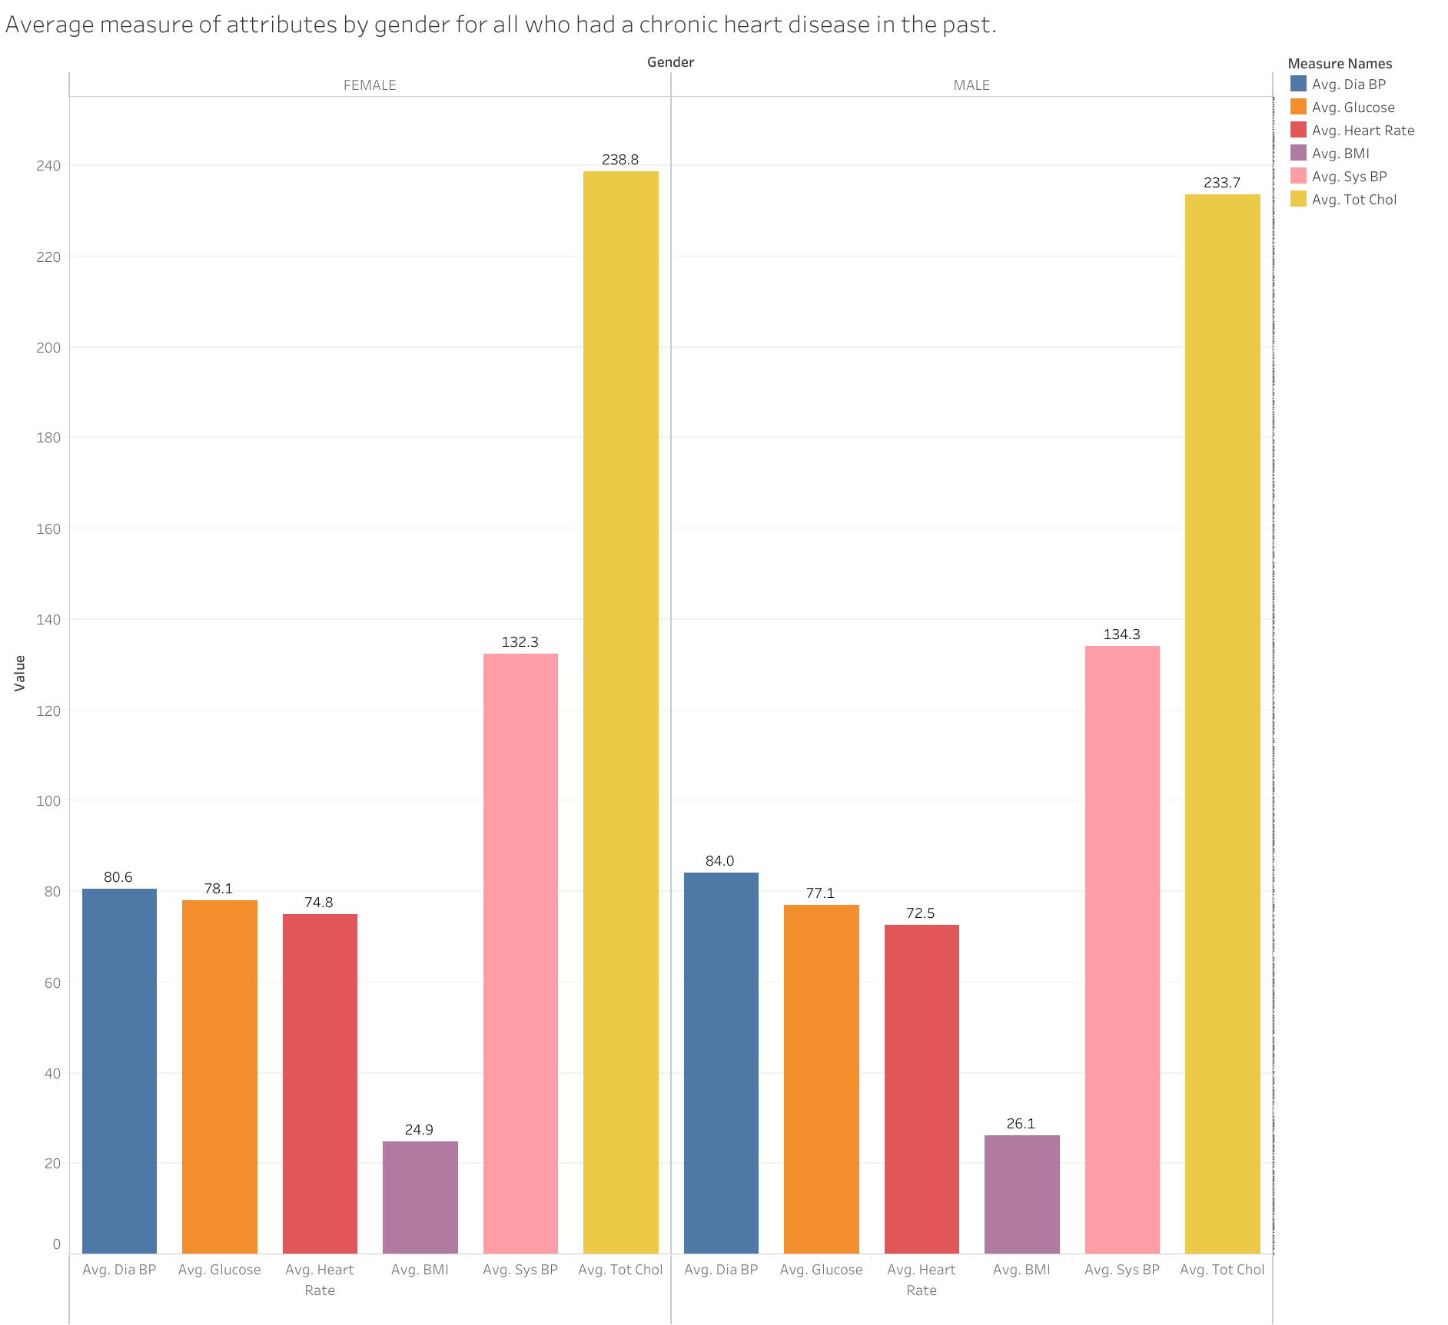
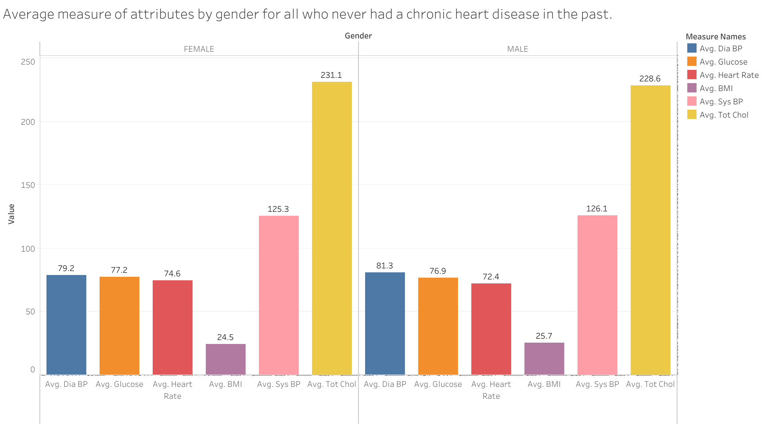
Comparative study of Men and Women with different underlying conditions shows hypertension, BP meds to be slightly corelated to CHD
Smoking and diabetes seems to be negatively correlated to CHD
Present underlying condition of BP and Cholesterol increases negligibly in the case of positive CHD
Source: https://www.kaggle.com/dileep070/heart-disease-prediction-using-logistic-regression

Slide 5
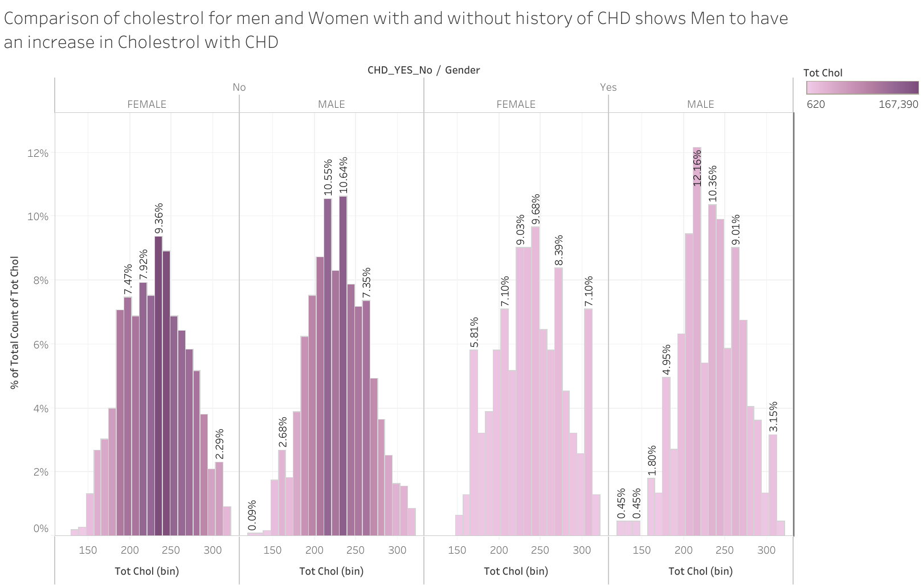
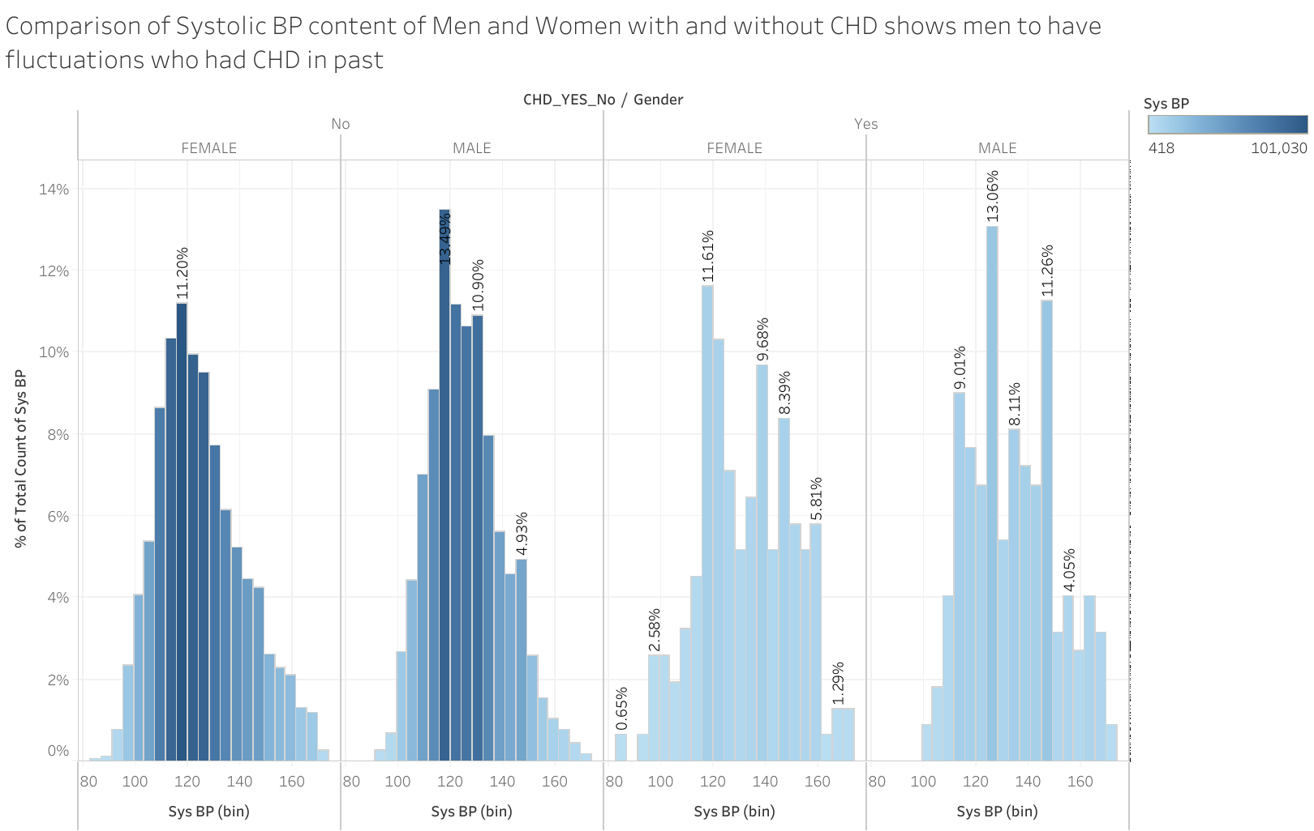
Comparison of Systolic BP and Cholesterol in the CHD positive and negative cases by gender shows some negligible fluctuations
Source: https://www.kaggle.com/dileep070/heart-disease-prediction-using-logistic-regression

Slide 6
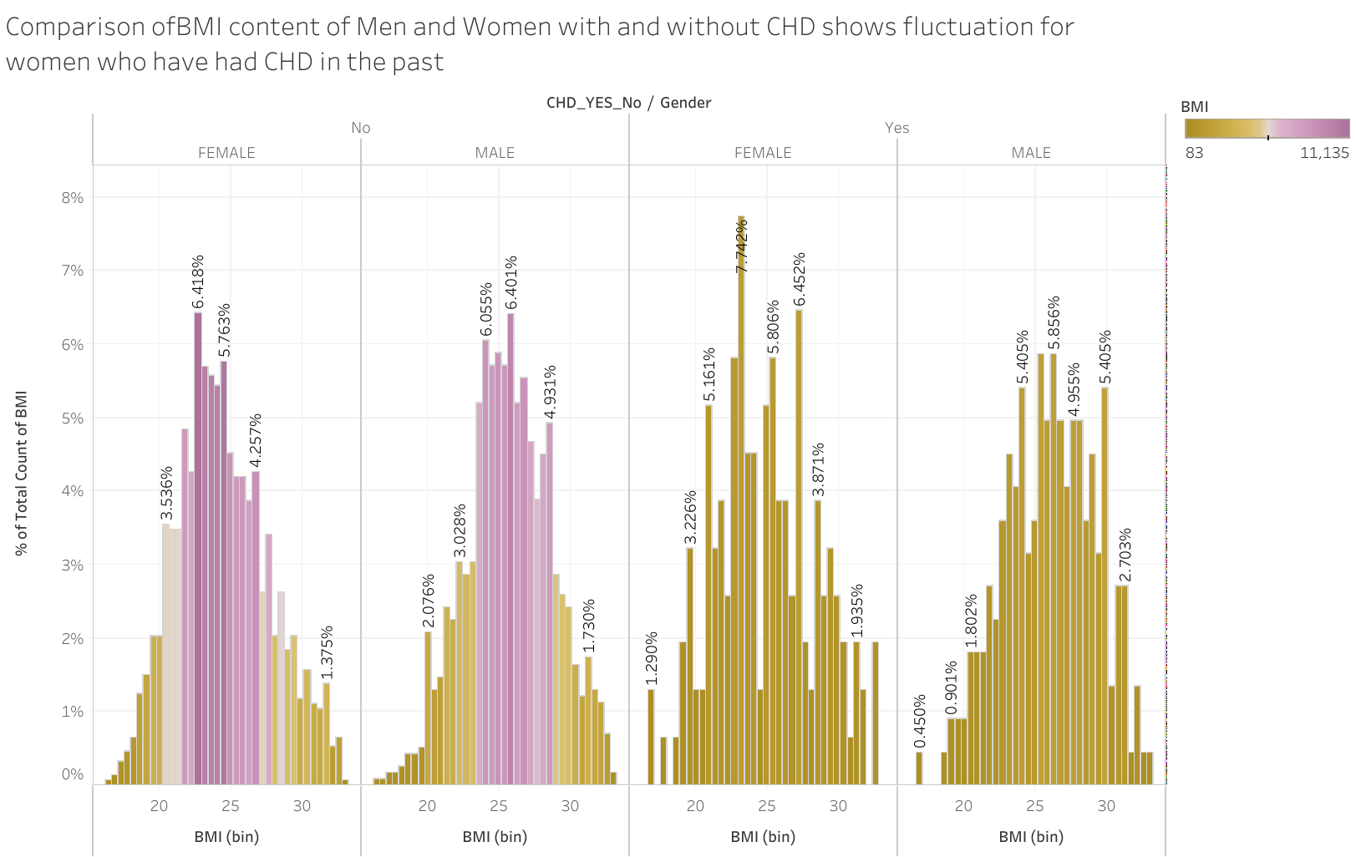
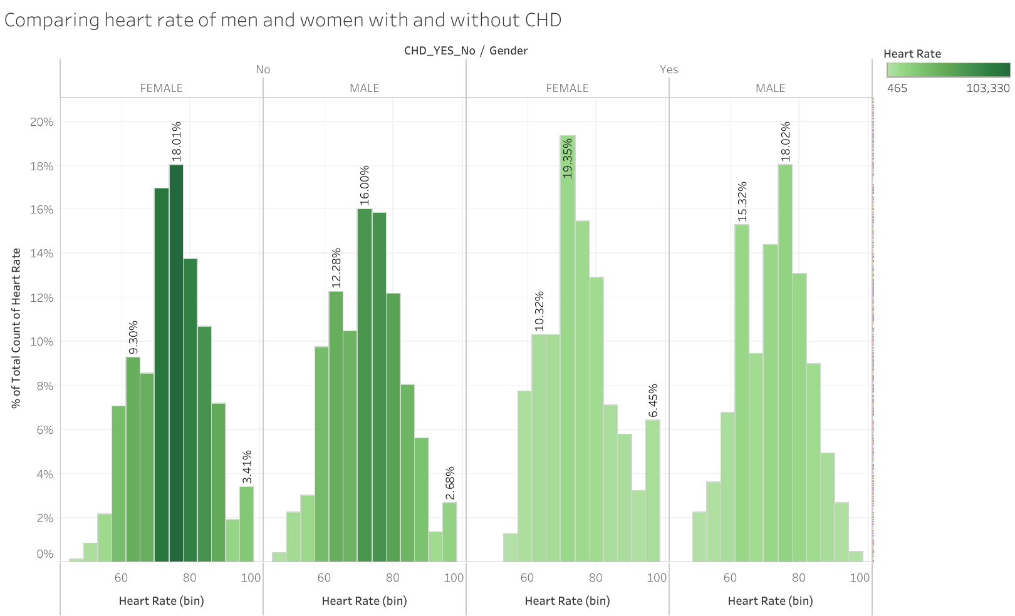
Comparison of BMI and Heart Rate in the CHD positive and negative cases by gender shows some increase in BMI of females in CHD positive. Heart rate changes are negligible.
Source: https://www.kaggle.com/dileep070/heart-disease-prediction-using-logistic-regression

Slide 7
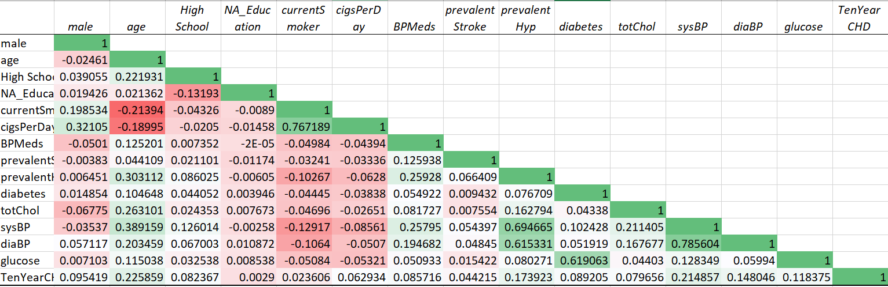
Further statistical analysis confirms very low correlation between the attributes and the Chronic Heart Disease.
A regression analysis showed a R Square value to be very low at 0.097114254

Slide 8

CONCLUSION
The sample dataset has very low percentage of People with a past in CHD.
The statistical analysis shows No or negligible correlation between the different attributes and CHD.
Hence not possible to derive a logical conclusion on what changes in lifestyle could decrease the chances of Chronic heart disease in high risk patients.
In order to derive a better conclusion we need to :
Include more positive cases in our dataset
Include data from more geographical area
Include more attributes that are likely to have stronger effect on CHD

